Slide 1
Conestoga info project
Team member: Jeong Jun Huh
Rakesh Dave
Shou Kui Wu
Presentation Date: April 24, 2014
Notes:
This template can be used as a starter file for presenting training materials in a group setting.
Sections
Right-click on a slide to add sections. Sections can help to organize your slides or facilitate collaboration between multiple authors.
Notes
Use the Notes section for delivery notes or to provide additional details for the audience. View these notes in Presentation View during your presentation.
Keep in mind the font size (important for accessibility, visibility, videotaping, and online production)
Coordinated colors
Pay particular attention to the graphs, charts, and text boxes.
Consider that attendees will print in black and white or grayscale. Run a test print to make sure your colors work when printed in pure black and white and grayscale.
Graphics, tables, and graphs
Keep it simple: If possible, use consistent, non-distracting styles and colors.
Label all graphs and tables.

Slide 2
Project Overview
To develop web app for Conestoga College’s website which can provide official answers from college for common questions.
Reduce cost for current search function.
Search function working on mobile device, increase the accessibility of official answers.
Notes:
Give a brief overview of the presentation. Describe the major focus of the presentation and why it is important.
Introduce each of the major topics.
To provide a road map for the audience, you can repeat this Overview slide throughout the presentation, highlighting the particular topic you will discuss next.

Slide 3




Methodology
Notes:
This is another option for an Overview slides using transitions.

Slide 4
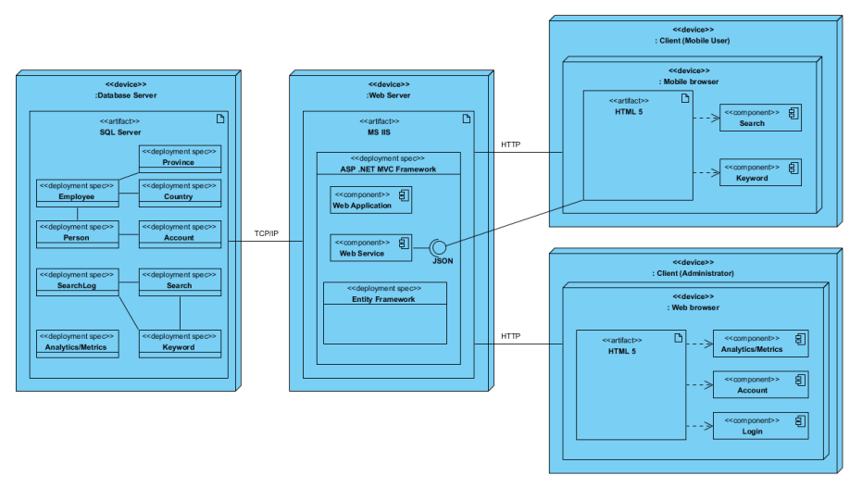
Software Architecture
Notes:
This is another option for an Overview slides using transitions.

Slide 5
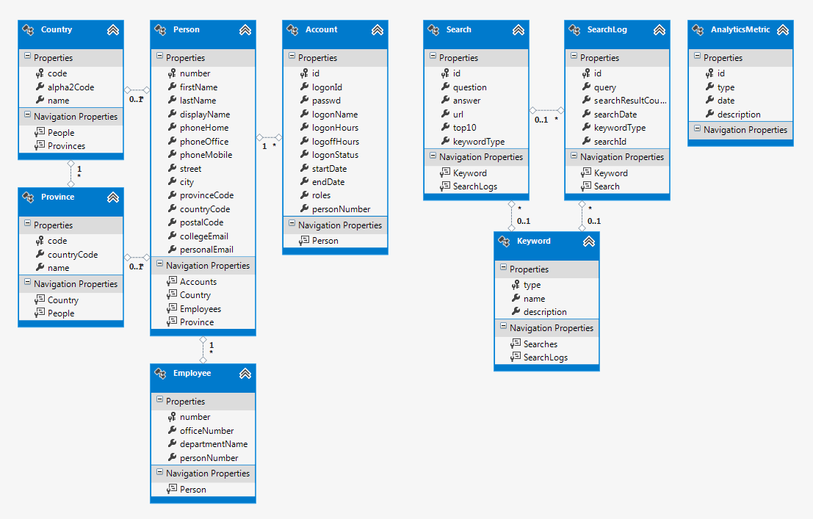
ERD diagram

Slide 6
Software detail:
jQuery mobile, HTML 5, CSS 3
AJAX, JSON/JSONP
WCF Web Service
ASP.NET MVC 4
SQL SERVER
Ripple Emulator, Android device

Slide 7

Features:
Search from own database, make sure the answer is official
Searching log analysis
Update most common question dynamically
Auto complete search keyword
Email from mobile device
Provide search session summary

Slide 8
Lesson learned:
Communication
Listen to your customer
Learn new technology
Following plan

Slide 9
Thank you
Mr. Andreas Kyriacou
Mr. Richard Hildred
And all people setting here
Notes:
Give a brief overview of the presentation. Describe the major focus of the presentation and why it is important.
Introduce each of the major topics.
To provide a road map for the audience, you can repeat this Overview slide throughout the presentation, highlighting the particular topic you will discuss next.

